Slide 1
Machine/Deep Learning
Linear Regression~
Softmax Classification
Chapter.2

Slide 2


Review
TensorFlow Mechanics
2. 그래프에 데이터(feed data)를 넣은다음 실행 시켜준다.(학습)
(sess.run(op, seed_dict={x:x_data})
3. 그래프의 실행결과로 변수값을 업데이트하고 과정을 반복한다.
(return values)
1. TensorFlow 실행을
위한 그래프를 구축한다.
(Build graph by Node)

Slide 3
Review
Linear Hypothesis
H(x) = Wx + b
Which hypothesis is better?
Hypothesis
3
2
cost
cost
1
0
0
1
2
3

Slide 4
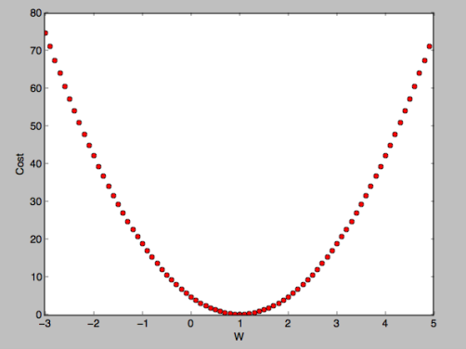
1.How to minimize cost
Hypothesis and Cost
H(x) = W x + b
cost(W, b) = 1/m $\sum_{i=1}^{m}{((H\left(x\left(i\right)\right)−y\left(i\right)) ^{2}}$
Simplified hypothesis
H(x) = W x
cost(W) = 1/m $\sum_{i=1}^{m}{(Wx(i)−y\left(i\right)) ^{2}}$
Looks like
Chapter.2

Slide 5
1.How to minimize cost
Minimize Cost
Gradient descent algorithm(경사 하강 알고리즘)
1. 임의의 W를 추측
2. 정해준 기준만큼(learning_rate)
기울기를 감소시킨다.
3. 기울기의 절대값이 최소가 될때 까지 반복한다.
Chapter.2

Slide 6
1.How to minimize cost
Minimize Cost
Formal definition
cost(W) = 1/m $\sum_{i=1}^{m}{(Wx(i)−y\left(i\right)) ^{2}}$
*미분하기 쉽게하기위해
cost(W) = 1/2m $\sum_{i=1}^{m}{(Wx(i)−y\left(i\right)) ^{2}}$
W(n+1) = W(n) -$α\frac{∂}{∂W}cost\left(W\left(n\right)\right)$ * $α$ = learning_rate
*일반화
W(n+1) = W(n) - $α /m\sum_{i=1}^{m}{\left(Wx\left(i\right)−y\left(i\right)\right)x(i)}$

Slide 7
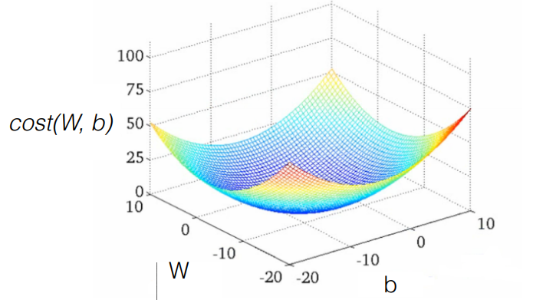
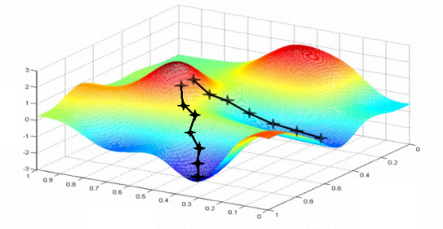
1.How to minimize cost
Minimize Cost
Convex function (볼록 함수)
If) cost(W, b) = 1/m $\sum_{i=1}^{m}{((H\left(x\left(i\right)\right)−y\left(i\right)) ^{2 }} ?$
볼록화

Slide 8
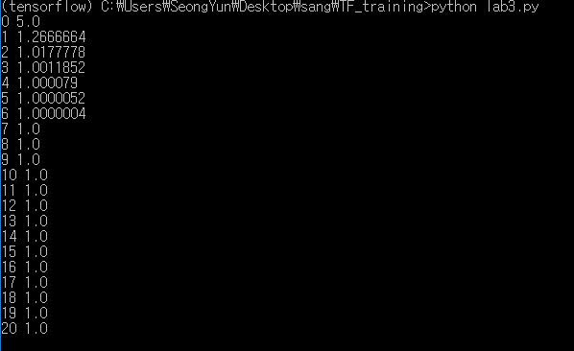
1.How to minimize cost
Minimize Cost(code)
import tensorflow as tf
#그래프 입력
X = [1, 2, 3]
Y = [1, 2, 3]
# W의 임의값 설정
W = tf.Variable(5.0)
hypothesis = X * W
cost/loss function 설정
cost = tf.reduce_mean(tf.square(hypothesis - Y))
# Minimize: Gradient Descent Magic:최소화
optimizer = tf.train.GradientDescentOptimizer(learning_rate=0.1)
train = optimizer.minimize(cost)
#실행
sess = tf.Session()
#그래프상의 변수 초기화
sess.run(tf.global_variables_initializer())
for step in range(21):
print(step, sess.run(W))
sess.run(train)
Learning_rate = 0.1
gradient = tf.reduce_mean((W * X - Y) * X)
descent = W - learning_rate * gradient
update = W.assign(descent)

Slide 9
2. Multi-variable Linear Regression
Multi-variable/feature
One-variable/One-feature
Multi-variable/feature
x (hours) | y (score)
10 | 90
9 | 80
3 | 50
2 | 60
11 | 40
x₁ (quiz 1) | x₂ (quiz 2) | x₃ (midterm 1) | Y (final)
73 | 80 | 75 | 152
93 | 88 | 93 | 185
89 | 91 | 90 | 180
96 | 98 | 100 | 196
73 | 66 | 70 | 142
instance

Slide 10
2. Multi-variable Linear Regression
Hypothesis
One-variable/One-feature
H(x) = Wx + b
Multi-variable/feature
H(x1, x2, x3) = w1x1 + w2x2 + w3x3 + b

Slide 11

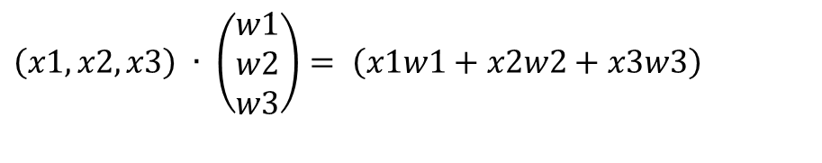
2. Multi-variable Linear Regression
Martix multiplication
Hypothesis using martix
H(x1, x2, x3) = w1x1 + w2x2 + w3x3 + b
$$\left(x1, x2, x3\right) ∙ \left(\begin{aligned}w1 \\ w2 \\ w3\end{aligned}\right)= \left(x1w1+x2w2+x3w3\right)$$
H(X) = XW
X
W
H(X)
[n, a] [b, m] [n, m]

Slide 12
2. Multi-variable Linear Regression
Multi-variable Code
import tensorflow as tf
x1_data = [73., 93., 89., 96., 73.]
x2_data = [80., 88., 91., 98., 66.]
x3_data = [75., 93., 90., 100., 70.]
y_data = [152., 185., 180., 196., 142.]
x1 = tf.placeholder(tf.float32)
x2 = tf.placeholder(tf.float32)
x3 = tf.placeholder(tf.float32)
Y = tf.placeholder(tf.float32)
w1 = tf.Variable(tf.random_normal([1]), name='weight1')
w2 = tf.Variable(tf.random_normal([1]), name='weight2')
w3 = tf.Variable(tf.random_normal([1]), name='weight3')
b = tf.Variable(tf.random_normal([1]), name='bias')
hypothesis = x1 * w1 + x2 * w2 + x3 * w3 + b
cost = tf.reduce_mean(tf.square(hypothesis - Y))
optimizer = tf.train.GradientDescentOptimizer(learning_rate=1e-5)
train = optimizer.minimize(cost)
sess = tf.Session()
sess.run(tf.global_variables_initializer())
for step in range(2001):
cost_val, hy_val, _ = sess.run([cost, hypothesis, train],
feed_dict={x1: x1_data, x2: x2_data, x3: x3_data, Y: y_data})
if step % 10 == 0:
print(step, "Cost: ", cost_val, "\nPrediction:\n", hy_val)
import tensorflow as tf
x_data = [[73., 80., 75.], [93., 88., 93.],
[89., 91., 90.], [96., 98., 100.], [73., 66., 70.]]
y_data = [[152.], [185.], [180.], [196.], [142.]]
X = tf.placeholder(tf.float32, shape=[None, 3])
Y = tf.placeholder(tf.float32, shape=[None, 1])
W = tf.Variable(tf.random_normal([3, 1]), name='weight')
b = tf.Variable(tf.random_normal([1]), name='bias')
hypothesis = tf.matmul(X, W) + b
cost = tf.reduce_mean(tf.square(hypothesis - Y))
optimizer = tf.train.GradientDescentOptimizer(learning_rate=1e-5)
train = optimizer.minimize(cost)
sess = tf.Session()
sess.run(tf.global_variables_initializer())
for step in range(2001):
cost_val, hy_val, _ = sess.run(
[cost, hypothesis, train], feed_dict={X: x_data, Y: y_data})
if step % 10 == 0:
print(step, "Cost: ", cost_val, "\nPrediction:\n", hy_val)
Complex!

Slide 13
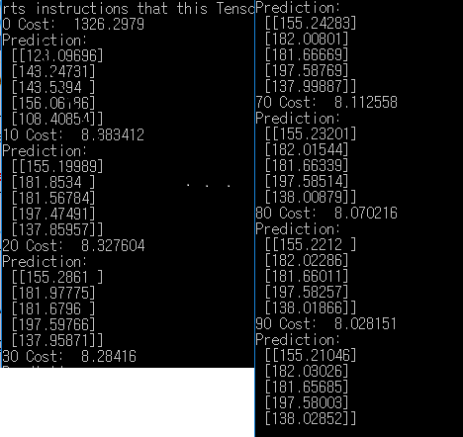
2. Multi-variable Linear Regression
Multi-variable Code
import tensorflow as tf
x_data = [[73., 80., 75.], [93., 88., 93.],
[89., 91., 90.], [96., 98., 100.], [73., 66., 70.]]
y_data = [[152.], [185.], [180.], [196.], [142.]]
X = tf.placeholder(tf.float32, shape=[None, 3])
Y = tf.placeholder(tf.float32, shape=[None, 1])
W = tf.Variable(tf.random_normal([3, 1]), name='weight')
b = tf.Variable(tf.random_normal([1]), name='bias')
hypothesis = tf.matmul(X, W) + b
cost = tf.reduce_mean(tf.square(hypothesis - Y))
optimizer = tf.train.GradientDescentOptimizer(learning_rate=1e-5)
train = optimizer.minimize(cost)
sess = tf.Session()
sess.run(tf.global_variables_initializer())
for step in range(2001):
cost_val, hy_val, _ = sess.run(
[cost, hypothesis, train], feed_dict={X: x_data, Y: y_data})
if step % 10 == 0:
print(step, "Cost: ", cost_val, "\nPrediction:\n", hy_val)
H(X) = XW
* 결과값
* Y 예측

Slide 14
2. Multi-variable Linear Regression
Multi-variable Load Data
Loading data from file
파일 명: data-01-test-score.csv
# EXAM1,EXAM2,EXAM3,FINAL
73,80,75,152
93,88,93,185
89,91,90,180
96,98,100,196
73,66,70,142
53,46,55,101
*Python에서 수학 및 과학연산을 위한 라이브러리
import numpy as np
xy = np.loadtxt('data-01-test-score.csv', delimiter=',', dtype=np.float32)
x_data = xy[:, 0:-1]
y_data = xy[:, [-1]]
print(x_data.shape, x_data, len(x_data))
print(y_data.shape, y_data)
파일명
구분방법
타입선정
*Slicing

Slide 15
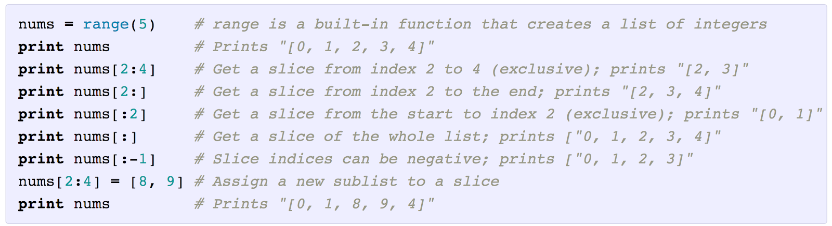
2. Multi-variable Linear Regression
Slicing
*NumPy 배열의 일부를 지정하여 해당원소들을 읽어오거나 변겨할수 있는 방법
x_data = xy[:, 0:-1] => 전체중 마지막을 제외한 데이터를 x_data라고 한다.
y_data = xy[:, [-1]] => 전체중 마지막 데이터만 y_data라고 한다.

Slide 16
2. Multi-variable Linear Regression
Load data code
* 구성
import tensorflow as tf
import numpy as np
tf.set_random_seed(777) # for reproducibility
xy = np.loadtxt('data-01-test-score.csv', delimiter=',', dtype=np.float32)
x_data = xy[:, 0:-1]
y_data = xy[:, [-1]]
print(x_data.shape, x_data, len(x_data))
print(y_data.shape, y_data)
X = tf.placeholder(tf.float32, shape=[None, 3])
Y = tf.placeholder(tf.float32, shape=[None, 1])
W = tf.Variable(tf.random_normal([3, 1]), name='weight')
b = tf.Variable(tf.random_normal([1]), name='bias')
hypothesis = tf.matmul(X, W) + b
cost = tf.reduce_mean(tf.square(hypothesis - Y))
optimizer = tf.train.GradientDescentOptimizer(learning_rate=1e-5)
train = optimizer.minimize(cost)
* 실행&출력
sess = tf.Session()
sess.run(tf.global_variables_initializer())
for step in range(2001):
cost_val, hy_val, _ = sess.run(
[cost, hypothesis, train],
feed_dict={X: x_data, Y: y_data})
if step % 10 == 0:
print(step, "Cost: ", cost_val,
"\nPrediction:\n", hy_val)
print("Your score will be ", sess.run(hypothesis,
feed_dict={X: [[100, 70, 101]]}))
print("Other scores will be ", sess.run(hypothesis,
feed_dict={X: [[60, 70, 110], [90, 100, 80]]}))
x_data 3개
y_data 1개
입력값:3개, 출력값:1개
출력값:1개

Slide 17
2. Multi-variable Linear Regression
Queue Runners(여러 개의 파일 로드)
여러 개의 파일을 로드하여 Queue에 쌓는다.
filename_queue = tf.train.string_input_producer([A.csv,B.csv,C.csv]
Shuffle = False, name=‘filename_queue’)
2. 리더를 설정한다 (텍스트, 바이너리 등,,)
3. 값을 디코딩 한다.
=>record_defaults = [[0.], [0.], [0.]]
xy = tf.decode_csv(value, record_defaults=record_defaults)

Slide 18
2. Multi-variable Linear Regression
Batch(일괄 처리)
tf.train.batch
train_x_batch, train_y_batch = \
tf.train.batch([xy[0:-1], xy[-1:]], batch_size=10)
sess = tf.Session()
...
# Start populating the filename queue.
coord = tf.train.Coordinator()
threads = tf.train.start_queue_runners(sess=sess, coord=coord)
for step in range(2001):
x_batch, y_batch = sess.run([train_x_batch, train_y_batch])
...
coord.request_stop()
coord.join(threads)
한번에 10개를 가져와라
Feed_dict로
값 설정

Slide 19
2. Multi-variable Linear Regression
Queue Runners Code
* 구성
* 실행&출력
import tensorflow as tf
filename_queue = tf.train.string_input_producer(
['data-01-test-score.csv'], shuffle=False, name='filename_queue')
reader = tf.TextLineReader()
key, value = reader.read(filename_queue)
record_defaults = [[0.], [0.], [0.], [0.]]
xy = tf.decode_csv(value, record_defaults=record_defaults)
train_x_batch, train_y_batch = \
tf.train.batch([xy[0:-1], xy[-1:]], batch_size=5 )
X = tf.placeholder(tf.float32, shape=[None, 3])
Y = tf.placeholder(tf.float32, shape=[None, 1])
W = tf.Variable(tf.random_normal([3, 1]), name='weight')
b = tf.Variable(tf.random_normal([1]), name='bias')
hypothesis = tf.matmul(X, W) + b
cost = tf.reduce_mean(tf.square(hypothesis - Y))
optimizer = tf.train.GradientDescentOptimizer(learning_rate=1e-5)
train = optimizer.minimize(cost)
sess = tf.Session()
sess.run(tf.global_variables_initializer())
coord = tf.train.Coordinator()
threads = tf.train.start_queue_runners(sess=sess, coord=coord)
for step in range(100):
x_batch, y_batch = sess.run([train_x_batch, train_y_batch])
cost_val, hy_val, _ = sess.run(
[cost, hypothesis, train],
feed_dict={X: x_batch, Y: y_batch})
if step % 10 == 0:
print(step, "Cost: ", cost_val,
"\nPrediction:\n", hy_val)
coord.request_stop()
coord.join(threads)
1
2
3
* 입력값이 주어질때 결과값 추측
print("Your score will be ", sess.run(hypothesis,
feed_dict={X: [[100, 70, 101]]}))
print("Other scores will be ", sess.run(hypothesis,
feed_dict={X: [[60, 70, 110], [90, 100, 80]]}))

Slide 20
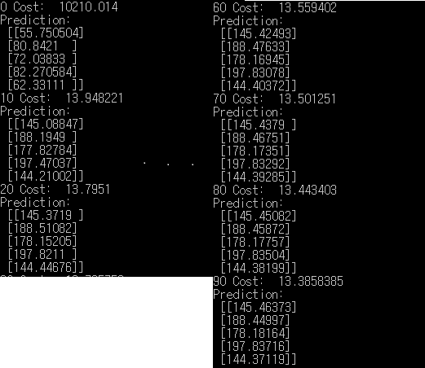

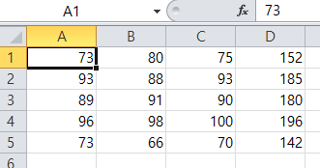
2. Multi-variable Linear Regression
Queue Runners Code
* 결과
* 결과 값(Y) 추측
['data-01-test-score.csv']

Slide 21
3. Logistic(regression) classification
Classification
Ex)
Spam Detection : Spam or Ham
Facebook feed:show or hide
Credit Card Fraudulent Transaction detection : legitimate/fraud
(신용카드의 사기 거래 탐지 : 합법/불법)
Binary화
Ex)
Spam Detection : Spam(1) or Ham(0)
Facebook feed:show(1) or hide(0)
Credit Card Fraudulent Transaction detection : legitimate(0)/fraud(1)

Slide 22
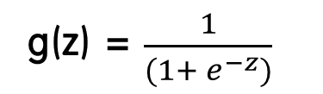
3. Logistic(regression) classification
Linear regression?(X) -> Logistic
Fail
Pass
Fail
Pass
1
1
0.5
0.5
0
0
0.2
0.5
0.7
1.3
1.5
1.7
0.2
0.5
0.7
1.3
1.5
1.7
10
1.0
1.4
기준이 바뀌어 버림
Linear regression의 문제점
Logistic regression
H(x) = Wx + b
H(x) => z , g(z) -> (0=<g(z)=<1)
g(z) = $\frac{1}{(1+ e^{−z})}$
Wx + b을 0, 1로 압축시킬 수 없을까?

Slide 23
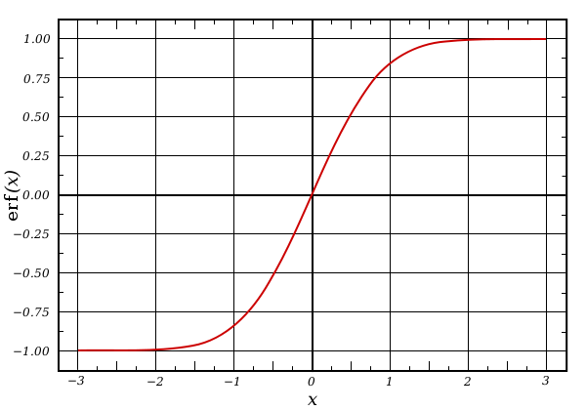
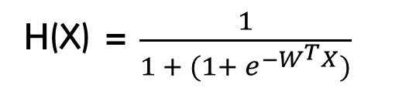
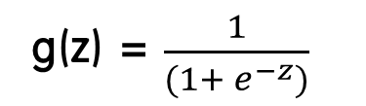

3. Logistic(regression) classification
Logistic Hypothesis
*Logistic(Sigmoid) Function(S자 모양의)
g(z) = $\frac{1}{(1+ e^{−z})}$
H(X) = $\frac{1}{1 + (1+ e^{−W^{T}X})}$
erf(x) = $\frac{1}{(1+ e^{−x})}$

Slide 24
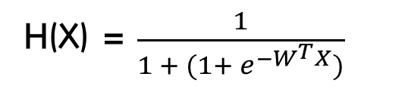
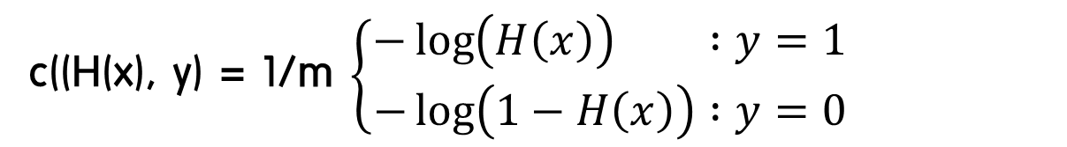
3. Logistic(regression) classification
Cost Funtion
H(x) = Wx + b
cost(W, b) = 1/m $\sum_{i=1}^{m}{((H\left(x\left(i\right)\right)−y\left(i\right)) ^{2}}$
H(X) = $\frac{1}{1 + (1+ e^{−W^{T}X})}$
cost(W) = 1/m $\sum{c(H\left(x\right), y) }$
c((H(x), y) = 1/m $\left\{\begin{aligned}−\log\left(H\left(x\right)\right) :y=1 \\ −\log\left(1−H\left(x\right)\right) :y=0\end{aligned}\right.$

Slide 25
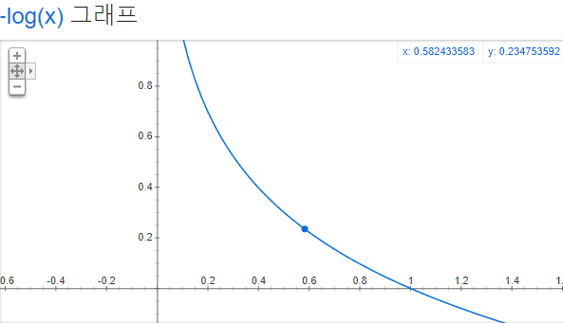
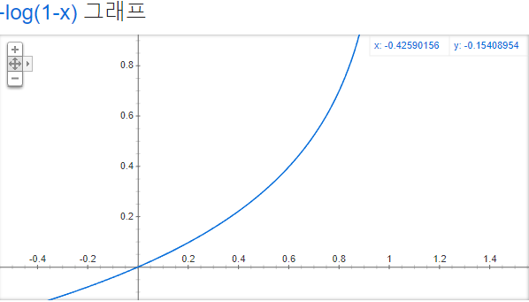
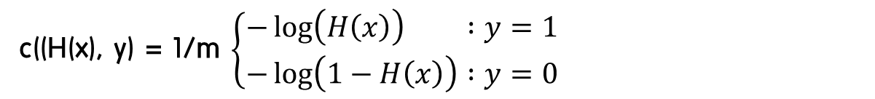
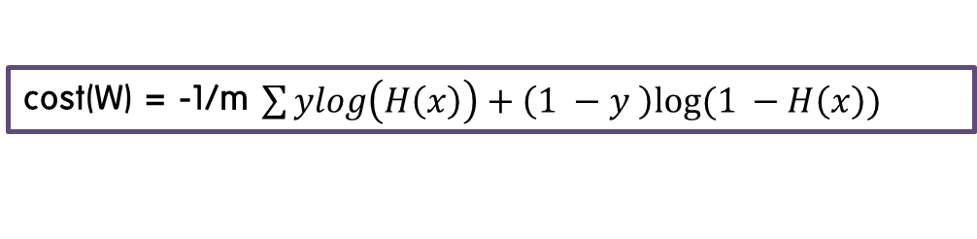
3. Logistic(regression) classification
Cost
c((H(x), y) = 1/m $\left\{\begin{aligned}−\log\left(H\left(x\right)\right) :y=1 \\ −\log\left(1−H\left(x\right)\right) :y=0\end{aligned}\right.$
H(x) = 1 => cost(1) = 0
H(x) = 1 => cost(1) = ∞
H(x) = 0 => cost(0) = ∞
H(x) = 0 => cost(0) = 0
cost(W) = -1/m $\sum{ylog\left(H\left(x\right)\right)+\left(1 −y \right)log⁡(1 −H\left(x\right)) }$

Slide 26
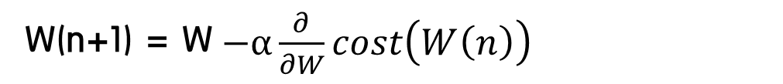
3. Logistic(regression) classification
Minimze Cost – Gradient Decent Algorithm
cost(W) = -1/m $\sum{ylog\left(H\left(x\right)\right)+\left(1 −y \right)log⁡(1 −H\left(x\right)) }$
W(n+1) = W$−α\frac{∂}{∂W}cost\left(W\left(n\right)\right)$
* cost function 만드는 코드
cost = tf.reduce_mean(-tf.reduce_sum(Y*tf.log(hypothesis) + (1-Y)*tf.log(1-hypothsis)))
* 최소화
a = tf.Variable(0, 1)
optimizer = tf.train.GradientDescentOptimizer(a)
train = optimizer.minimize(cost)

Slide 27
3. Logistic(regression) classification
Minimze Cost – Gradient Decent Algorithm
cost(W) = -1/m $\sum{ylog\left(H\left(x\right)\right)+\left(1 −y \right)log⁡(1 −H\left(x\right)) }$
W(n+1) = W$−α\frac{∂}{∂W}cost\left(W\left(n\right)\right)$
* cost function 만드는 코드
cost = tf.reduce_mean(-tf.reduce_sum(Y*tf.log(hypothesis) + (1-Y)*tf.log(1-hypothsis)))
* 최소화
a = tf.Variable(0, 1)
optimizer = tf.train.GradientDescentOptimizer(a)
train = optimizer.minimize(cost)

Slide 28
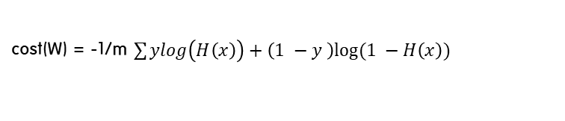

3. Logistic(regression) classification
Logistic Classification Code
* 구성
* 실행&출력
import tensorflow as tf
x_data = [[1, 2], [2, 3], [3, 1], [4, 3], [5, 3], [6, 2]]
y_data = [[0], [0], [0], [1], [1], [1]]
X = tf.placeholder(tf.float32, shape=[None, 2])
Y = tf.placeholder(tf.float32, shape=[None, 1])
W = tf.Variable(tf.random_normal([2, 1]), name='weight')
b = tf.Variable(tf.random_normal([1]), name='bias')
#가설 입력
hypothesis = tf.sigmoid(tf.matmul(X, W) + b)
# cost/loss function
cost = -tf.reduce_mean(Y * tf.log(hypothesis) + (1 - Y) *
tf.log(1 - hypothesis))
train = tf.train.GradientDescentOptimizer(learning_rate=0.01).minimize(cost)
# Accuracy computation
# True if hypothesis>0.5 else False(true 는 0.5보다 큰 값이다.)
predicted = tf.cast(hypothesis > 0.5, dtype=tf.float32)
accuracy = tf.reduce_mean(tf.cast(tf.equal(predicted, Y), dtype=tf.float32))
with tf.Session() as sess:
# Initialize TensorFlow variables
sess.run(tf.global_variables_initializer())
for step in range(10001):
cost_val, _ = sess.run([cost, train], feed_dict={X: x_data, Y: y_data})
if step % 200 == 0:
print(step, cost_val)
# Accuracy report
h, c, a = sess.run([hypothesis, predicted, accuracy],
feed_dict={X: x_data, Y: y_data})
print("\nHypothesis: ", h, "\nCorrect (Y): ", c, "\nAccuracy: ", a)
Fail
Pass
데이터의 수 : n
H(X) = $\frac{1}{1 + (1+ e^{−W^{T}X})}$
cost(W) = -1/m $\sum{ylog\left(H\left(x\right)\right)+\left(1 −y \right)log⁡(1 −H\left(x\right)) }$
W(n+1) = W$−α\frac{∂}{∂W}cost\left(W\left(n\right)\right)$

Slide 29
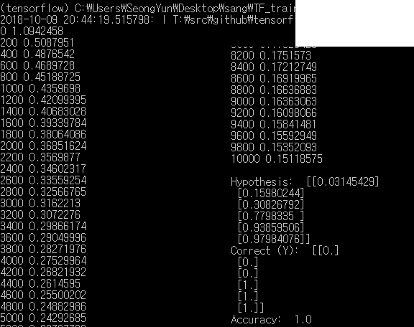
3. Logistic(regression) classification
Logistic Classification Code
* 결과
y_data = [[0], [0], [0], [1], [1], [1]]
100% 일치!

Slide 30
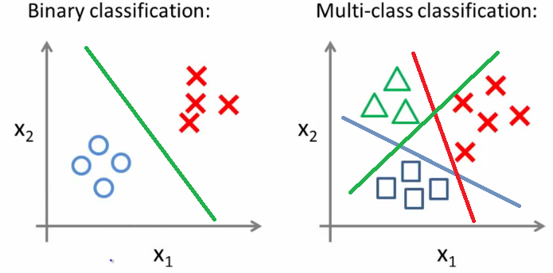
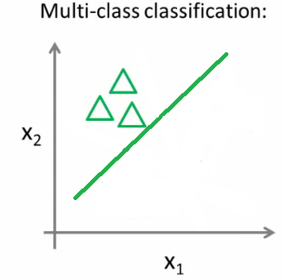
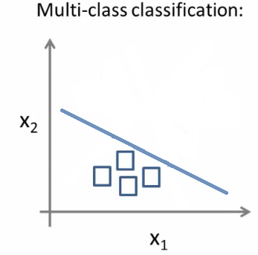
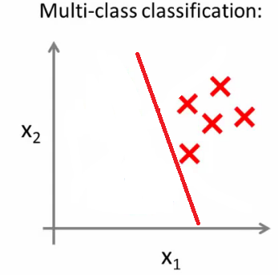
4. Softmax Regression
Multinomial classification
=>여러 개 Class(Y)의 Logistic regression
△ or not
□ or not
X or not

Slide 31
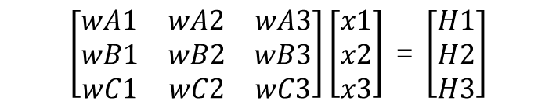
4. Softmax Regression
Multinomial classification
△ or not
□ or not
X or not
H1=W(A)x + b
H2=W(B)x + b
H3=W(C)x + b
H1=XW(A)
H2=XW(B)
H3=XW(C)
$\left[\begin{matrix}wA1 & wA2 & wA3 \\ wB1 & wB2 & wB3 \\ wC1 & wC2 & wC3\end{matrix}\right]\left[\begin{aligned}x1 \\ x2 \\ x3\end{aligned}\right]$ = $\left[\begin{aligned}H1 \\ H2 \\ H3\end{aligned}\right]$
행렬화 =>
Where is sigmoid?

Slide 32





4. Softmax Regression
Softmax
Where is sigmoid?
$\left[\begin{matrix}wA1 & wA2 & wA3 \\ wB1 & wB2 & wB3 \\ wC1 & wC2 & wC3\end{matrix}\right]\left[\begin{aligned}x1 \\ x2 \\ x3\end{aligned}\right]$ = $\left[\begin{aligned}H1 \\ H2 \\ H3\end{aligned}\right]$ , WX = Y
Logistic Classifier
Y = $\left[\begin{aligned}a \\ b \\ c\end{aligned}\right]$ → a + b + c = 1
Softmax function
Y = $\left[\begin{aligned}H1 \\ H2 \\ H3\end{aligned}\right]$ →
S(yi) = $\frac{e^{yi}}{\sum{e^{yj}}}$
→ $\left[\begin{aligned}a \\ b \\ c\end{aligned}\right]$
→ One – Hot Encoding →
Ex) $\left[\begin{aligned}a \\ b \\ c\end{aligned}\right]$ ← ? → $\left[\begin{aligned}1.0 \\ 0 \\ 0\end{aligned}\right]$ A(△)가 정답(실제값)

Slide 33

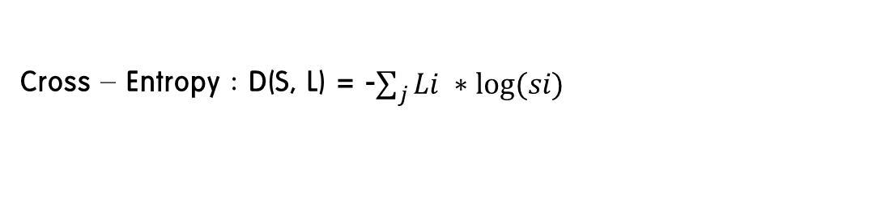

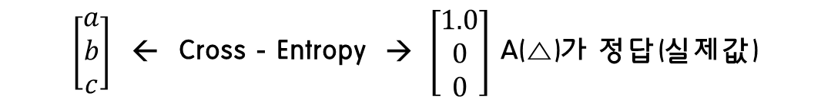


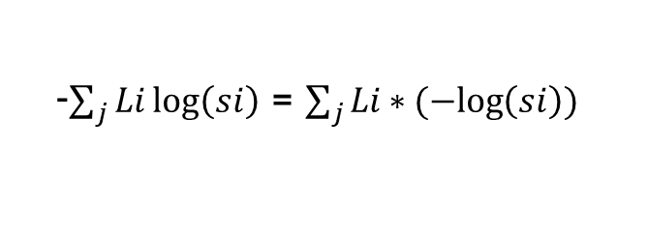

4. Softmax Regression
Cross-entropy
Cross-entropy cost funtion
$\left[\begin{aligned}a \\ b \\ c\end{aligned}\right]$ ← Cross - Entropy → $\left[\begin{aligned}1.0 \\ 0 \\ 0\end{aligned}\right]$ A(△)가 정답(실제값)
S(y)
L(y)
Cross – Entropy : D(S, L) = -$\sum_{j}{Li ∗log⁡(si)}$
-$\sum_{j}{Li\log\left(si\right)}$ = $\sum_{j}{Li∗(−log\left(si\right))}$
0~1 값
Ex) 실제값: $\left[\begin{aligned}0 \\ 1\end{aligned}\right]$
예측1:$\left[\begin{aligned}0 \\ 1\end{aligned}\right]($정답:cost를 낮춰야함)
$\left[\begin{aligned}0 \\ 1\end{aligned}\right]∗−log\left[\begin{aligned}0 \\ 1\end{aligned}\right]=\left[\begin{aligned}0 \\ 1\end{aligned}\right]$ * $\left[\begin{aligned}∞ \\ 0\end{aligned}\right]$ = $\left[\begin{aligned}0 \\ 0\end{aligned}\right]$ → 0
예측2:$\left[\begin{aligned}1 \\ 0\end{aligned}\right]($정답:cost를 높아져야함)
$\left[\begin{aligned}0 \\ 1\end{aligned}\right]∗−log\left[\begin{aligned}1 \\ 0\end{aligned}\right]=\left[\begin{aligned}0 \\ 1\end{aligned}\right]$ * $\left[\begin{aligned}0 \\ ∞\end{aligned}\right]$ = $\left[\begin{aligned}0 \\ ∞\end{aligned}\right]$ → $∞$

Slide 34
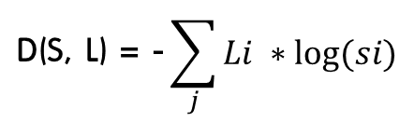

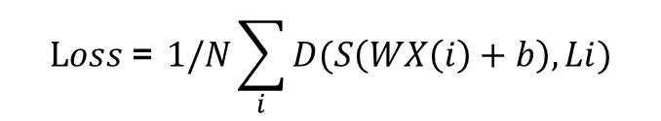
4. Softmax Regression
Logistic cost VS Cross entropy
Logistic Cost
$$C:\left(H\left(x\right), y\right)=−ylog\left(H\left(x\right)\right)+\left(1 −y \right)log⁡(1 −H\left(x\right))$$
Cross entropy
$$\text{D}\text{(}\text{S}\text{, }\text{L}\text{) = −}\sum_{j}{Li ∗log⁡(si)}$$
$$C:\left(Si, Li\right)=−Lilog\left(Si\right)+\left(1−Li \right)log⁡(1 −Si)$$
두개의 예측 및 결과만 있기 때문에
Cost funtion
$$Loss \text{= }1/N\sum_{i}{D(S\left(WX\left(i\right)+b\right),Li)}$$
Gradient descent
-$α∆$Loss(w1, w2) :루즈값을 미분한 것

Slide 35


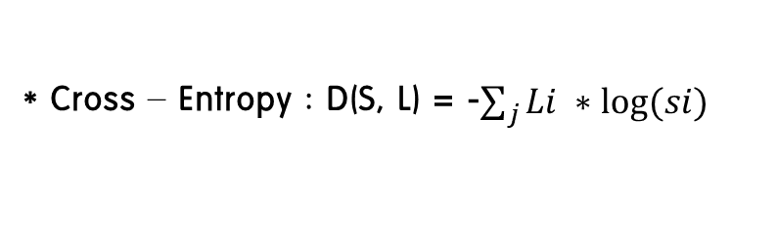
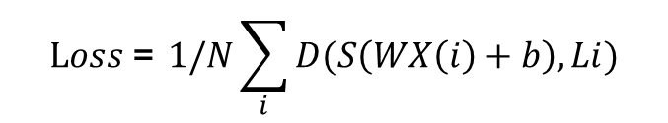

4. Softmax Regression
Softmax function Code
Hypothesis = tf.nn.softmax(tf.matmul(X, W)+b)
==> Softmax function
Matmul(X,W)+b=
Y = $\left[\begin{aligned}H1 \\ H2 \\ H3\end{aligned}\right]$ →
S(yi) = $\frac{e^{yi}}{\sum{e^{yj}}}$
→ $\left[\begin{aligned}a \\ b \\ c\end{aligned}\right]$
Scores
(Logit)
Probabilities
$$Loss \text{= }1/N\sum_{i}{D(S\left(WX\left(i\right)+b\right),Li)}$$
Cost function: cross entropy
Cost = tf.reduce_mean(-tf.reduce_sum(Y * tf.log(hypothesis), axis(중심선)=1))
* Cross – Entropy : D(S, L) = -$\sum_{j}{Li ∗log⁡(si)}$
Optimizer = tf.train.GradentDescentOptimizer(learning_rate=0.1).minimize(cost)

Slide 36

4. Softmax Regression
Softmax function Code
* 구성
* 실행&출력
import tensorflow as tf
x_data = [[1, 2, 1, 1], [2, 1, 3, 2], [3, 1, 3, 4], [4, 1, 5, 5], [1, 7, 5, 5],
[1, 2, 5, 6], [1, 6, 6, 6], [1, 7, 7, 7]]
y_data = [[0, 0, 1], [0, 0, 1], [0, 0, 1], [0, 1, 0], [0, 1, 0], [0, 1, 0], [1, 0, 0], [1, 0, 0]]
X = tf.placeholder("float", [None, 4])
Y = tf.placeholder("float", [None, 3])
nb_classes = 3 #정적변수
W = tf.Variable(tf.random_normal([4, nb_classes]), name='weight')
b = tf.Variable(tf.random_normal([nb_classes]), name='bias')
# softmax activations
# softmax = exp(logits) / reduce_sum(exp(logits), dim)
hypothesis = tf.nn.softmax(tf.matmul(X, W) + b)
# Cross entropy cost/loss
cost = tf.reduce_mean(-tf.reduce_sum(Y * tf.log(hypothesis), axis=1))
optimizer = tf.train.GradientDescentOptimizer(learning_rate=0.1).minimize(cost)
with tf.Session() as sess:
sess.run(tf.global_variables_initializer())
for step in range(2001):
sess.run(optimizer, feed_dict={X: x_data, Y: y_data})
all = sess.run(hypothesis, feed_dict={X: [[1, 11, 7, 9],[1, 3, 4, 3],[1, 1, 0, 1]]
if step % 200 == 0:
print(step, sess.run(cost, feed_dict={X: x_data, Y: y_data}))
Print(all, sess.run(tf.arg_max(all, 1)))
S(yi) = $\frac{e^{yi}}{\sum{e^{yj}}}$

Slide 37
4. Softmax Regression
Softmax function Code(출력)
* Test & one-hot encoding
a = sess.run(hypothesis, feed_dict={X: [[1, 11, 7, 9]]
Print(a, sess.run(tf.arg_max(a, 1)))
가장 큰값을 정해준다.
a = [[0.003 0.9 0.097]]
[1] → [0 1 2] 1이 가장크다.
all = sess.run(hypothesis, feed_dict={X: [[1, 11, 7, 9],[1, 3, 4, 3],[1, 1, 0, 1]]
Print(all, sess.run(tf.arg_max(all, 1)))
all = [[0.003 0.9 0.097][0.9 0.06 0.04][0.001 0.009 0.9]]
=> [1 0 2]

Slide 38
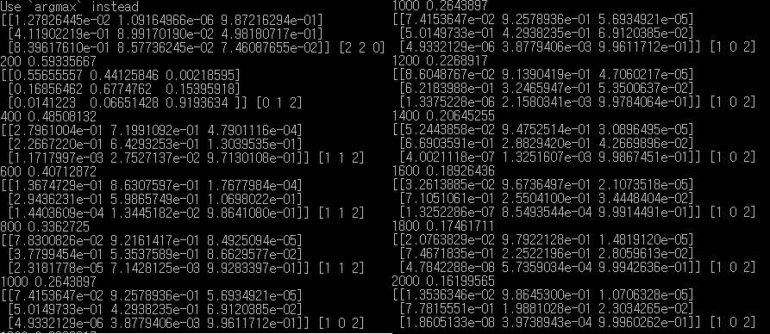
4. Softmax Regression
Softmax function Code(결과)
X: [[1, 11, 7, 9],[1, 3, 4, 3],[1, 1, 0, 1]]
Y: [[0, 1, 0],[1, 0, 0],[0, 0, 1]]

Slide 39
4. Softmax Regression
Fancy Softmax function Code
1. Softmax_cross_entropy_with_logits
Logits = tf.matmul(X, W) + b
Hypothesis = tf.nn.softmax(logits)
One-hot
cost = tf.reduce_mean(-tf.reduce_sum(Y * tf.log(hypothesis), axis = 1))
cost_i = tf.nn.softmax_cross_entropy_with_logits(logits=logits, labels=Y_one_hot)
cost = tf.reduce_mean(cost_i)

Slide 40
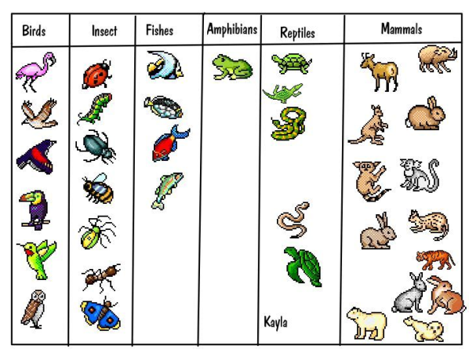
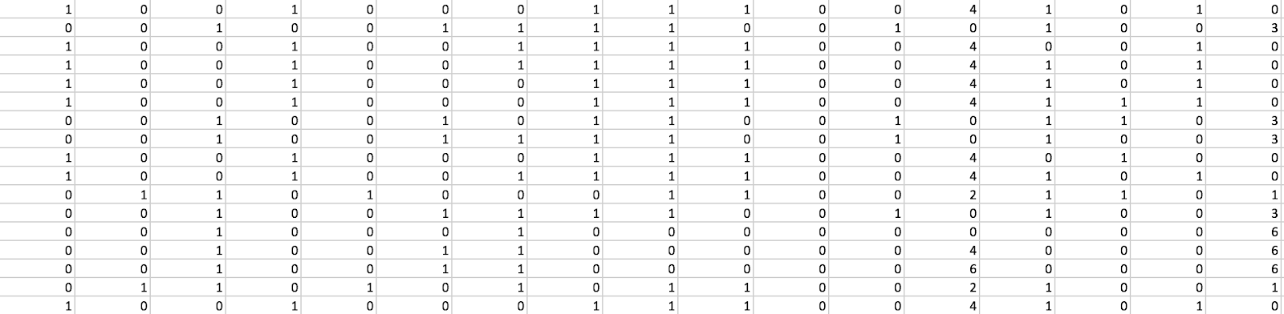
4. Softmax Regression
Example(Animal Classification)
동물들을 분류(x_data = 특징,
y_data = 새, 벌레, 물고기, 포유류)
특징들 머리의 개수, 다리의 개수, 귀의 개수등등,,,

Slide 41
4. Softmax Regression
Example(Animal Classification)
tf.one_hot and reshape
If) nb_classes = 7 일경우
Y = tf.placeholder(tf.int32, [None, 1]) # 0 ~ 6, shape=(?, 1)
Y_one_hot = tf.one_hot(Y, nb_classes) # one hot shape=(?, 1, 7)
Y_one_hot = tf.reshape(Y_one_hot, [-1, nb_classes]) # shape=(?, 7)
Y = [[0], [3]]
Y = [[0], [3]] ➔ [[1000000]] [[0001000]]
Y = [[1000000]] [[0001000]] ➔ [[1000000], [0001000]]

Slide 42
4. Softmax Regression
Example(Animal Classification)
* 구성
import tensorflow as tf
xy = np.loadtxt('data-04-zoo.csv', delimiter=',', dtype=np.float32)
x_data = xy[:, 0:-1]
y_data = xy[:, [-1]]
nb_classes = 7 # 0 ~ 6
X = tf.placeholder(tf.float32, [None, 16])
Y = tf.placeholder(tf.int32, [None, 1]) # 0 ~ 6
Y_one_hot = tf.one_hot(Y, nb_classes) # one hot
Y_one_hot = tf.reshape(Y_one_hot, [-1, nb_classes])
W = tf.Variable(tf.random_normal([16, nb_classes]), name='weight')
b = tf.Variable(tf.random_normal([nb_classes]), name='bias')
# tf.nn.softmax computes softmax activations
# softmax = exp(logits) / reduce_sum(exp(logits), dim)
logits = tf.matmul(X, W) + b
hypothesis = tf.nn.softmax(logits)
# Cross entropy cost/loss
cost_i = tf.nn.softmax_cross_entropy_with_logits(logits=logits,
labels=Y_one_hot)
cost = tf.reduce_mean(cost_i)
optimizer = tf.train.GradientDescentOptimizer(learning_rate=0.1).minimize(cost)
* 실행&출력
prediction = tf.argmax(hypothesis, 1)
correct_prediction = tf.equal(prediction, tf.argmax(Y_one_hot, 1))
accuracy = tf.reduce_mean(tf.cast(correct_prediction, tf.float32))
# Launch graph
with tf.Session() as sess:
sess.run(tf.global_variables_initializer())
for step in range(2000):
sess.run(optimizer, feed_dict={X: x_data, Y: y_data})
if step % 100 == 0:
loss, acc = sess.run([cost, accuracy], feed_dict={
X: x_data, Y: y_data})
print("Step: {:5}\tLoss: {:.3f}\tAcc: {:.2%}".format(
step, loss, acc))
# Let's see if we can predict
pred = sess.run(prediction, feed_dict={X: x_data})
# y_data: (N,1) = flatten => (N, ) matches pred.shape
for p, y in zip(pred, y_data.flatten()):
print("[{}] Prediction: {} True Y: {}".format(p == int(y), p, int(y)))
Everything

Slide 43
4. Softmax Regression
Example(Animal Classification)
* 구성
import tensorflow as tf
xy = np.loadtxt('data-04-zoo.csv', delimiter=',', dtype=np.float32)
x_data = xy[:, 0:-1]
y_data = xy[:, [-1]]
nb_classes = 7 # 0 ~ 6
X = tf.placeholder(tf.float32, [None, 16])
Y = tf.placeholder(tf.int32, [None, 1]) # 0 ~ 6
Y_one_hot = tf.one_hot(Y, nb_classes) # one hot
Y_one_hot = tf.reshape(Y_one_hot, [-1, nb_classes])
W = tf.Variable(tf.random_normal([16, nb_classes]), name='weight')
b = tf.Variable(tf.random_normal([nb_classes]), name='bias')
# tf.nn.softmax computes softmax activations
# softmax = exp(logits) / reduce_sum(exp(logits), dim)
logits = tf.matmul(X, W) + b
hypothesis = tf.nn.softmax(logits)
# Cross entropy cost/loss
cost_i = tf.nn.softmax_cross_entropy_with_logits(logits=logits,
labels=Y_one_hot)
cost = tf.reduce_mean(cost_i)
optimizer = tf.train.GradientDescentOptimizer(learning_rate=0.1).minimize(cost)
prediction = tf.argmax(hypothesis, 1)
correct_prediction = tf.equal(prediction, tf.argmax(Y_one_hot, 1))
accuracy = tf.reduce_mean(tf.cast(correct_prediction, tf.float32))
with tf.Session() as sess:
sess.run(tf.global_variables_initializer())
for step in range(2000):
sess.run(optimizer, feed_dict={X: x_data, Y: y_data})
if step % 100 == 0:
loss, acc = sess.run([cost, accuracy], feed_dict={
X: x_data, Y: y_data})
print("Step: {:5}\tLoss: {:.3f}\tAcc: {:.2%}".format(
step, loss, acc))
# Let's see if we can predict
pred = sess.run(prediction, feed_dict={X: x_data})
# y_data: (N,1) = flatten => (N, ) matches pred.shape
for p, y in zip(pred, y_data.flatten()):
print("[{}] Prediction: {} True Y: {}".format(p == int(y), p, int(y)))
* 실행&출력
Everything

Slide 44
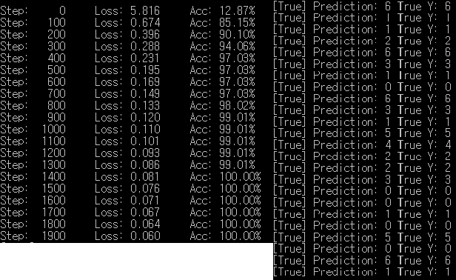
4. Softmax Regression
Example(Animal Classification)
*결과
학습할 수록 정확도 증가
일치

Slide 45
END & Q/A

